Slide 1
MARINE CORPS LEAGUE
MARKSMANSHIP COMPETITION

Slide 2
Divisions To Compete In
Service Rifle
Service Rifle with optics
22 LR Rifle
22 LR Rifle with optics
Service Pistol
Open Pistol
22 LR Pistol

Slide 3
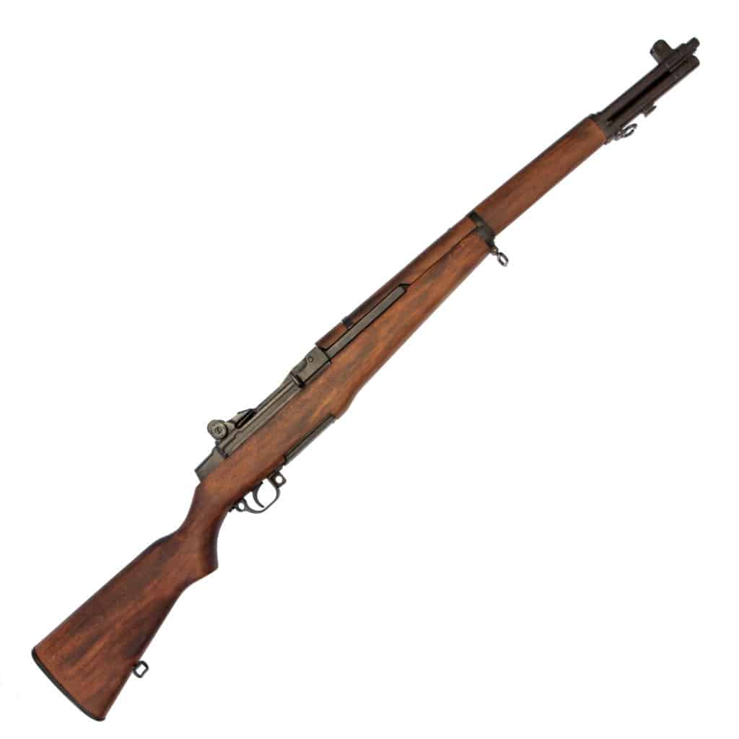
Service Rifle and Optics Rifle
The following rifles are acceptable
M1903 SPRINGFIELD
M1 GARAND
M1A/M14
AR-15/M-16 UP TO 20” BARREL

Slide 4
Service Rifle/Optics Rifle Course Of Fire
3 sighters in 3 minutes
Prone: 15 rounds in 15 minutes
Sitting: 15 rounds in 15 minutes
Standing: 10 rounds in 10 minutes
(Kneeling position may be used for any position but standing)

Slide 5
Service Rifle Special Rules
If you can’t get into a position, you may use the next hardest position.
Disabled competitors can shoot from any position or a chair.
No external modification allowed to stock or barrel.
Iron sights only in service rifle, optics only in optics class
Sling support is allowed.
No magnification above 4x.
22LR class follows all the same rules.

Slide 6
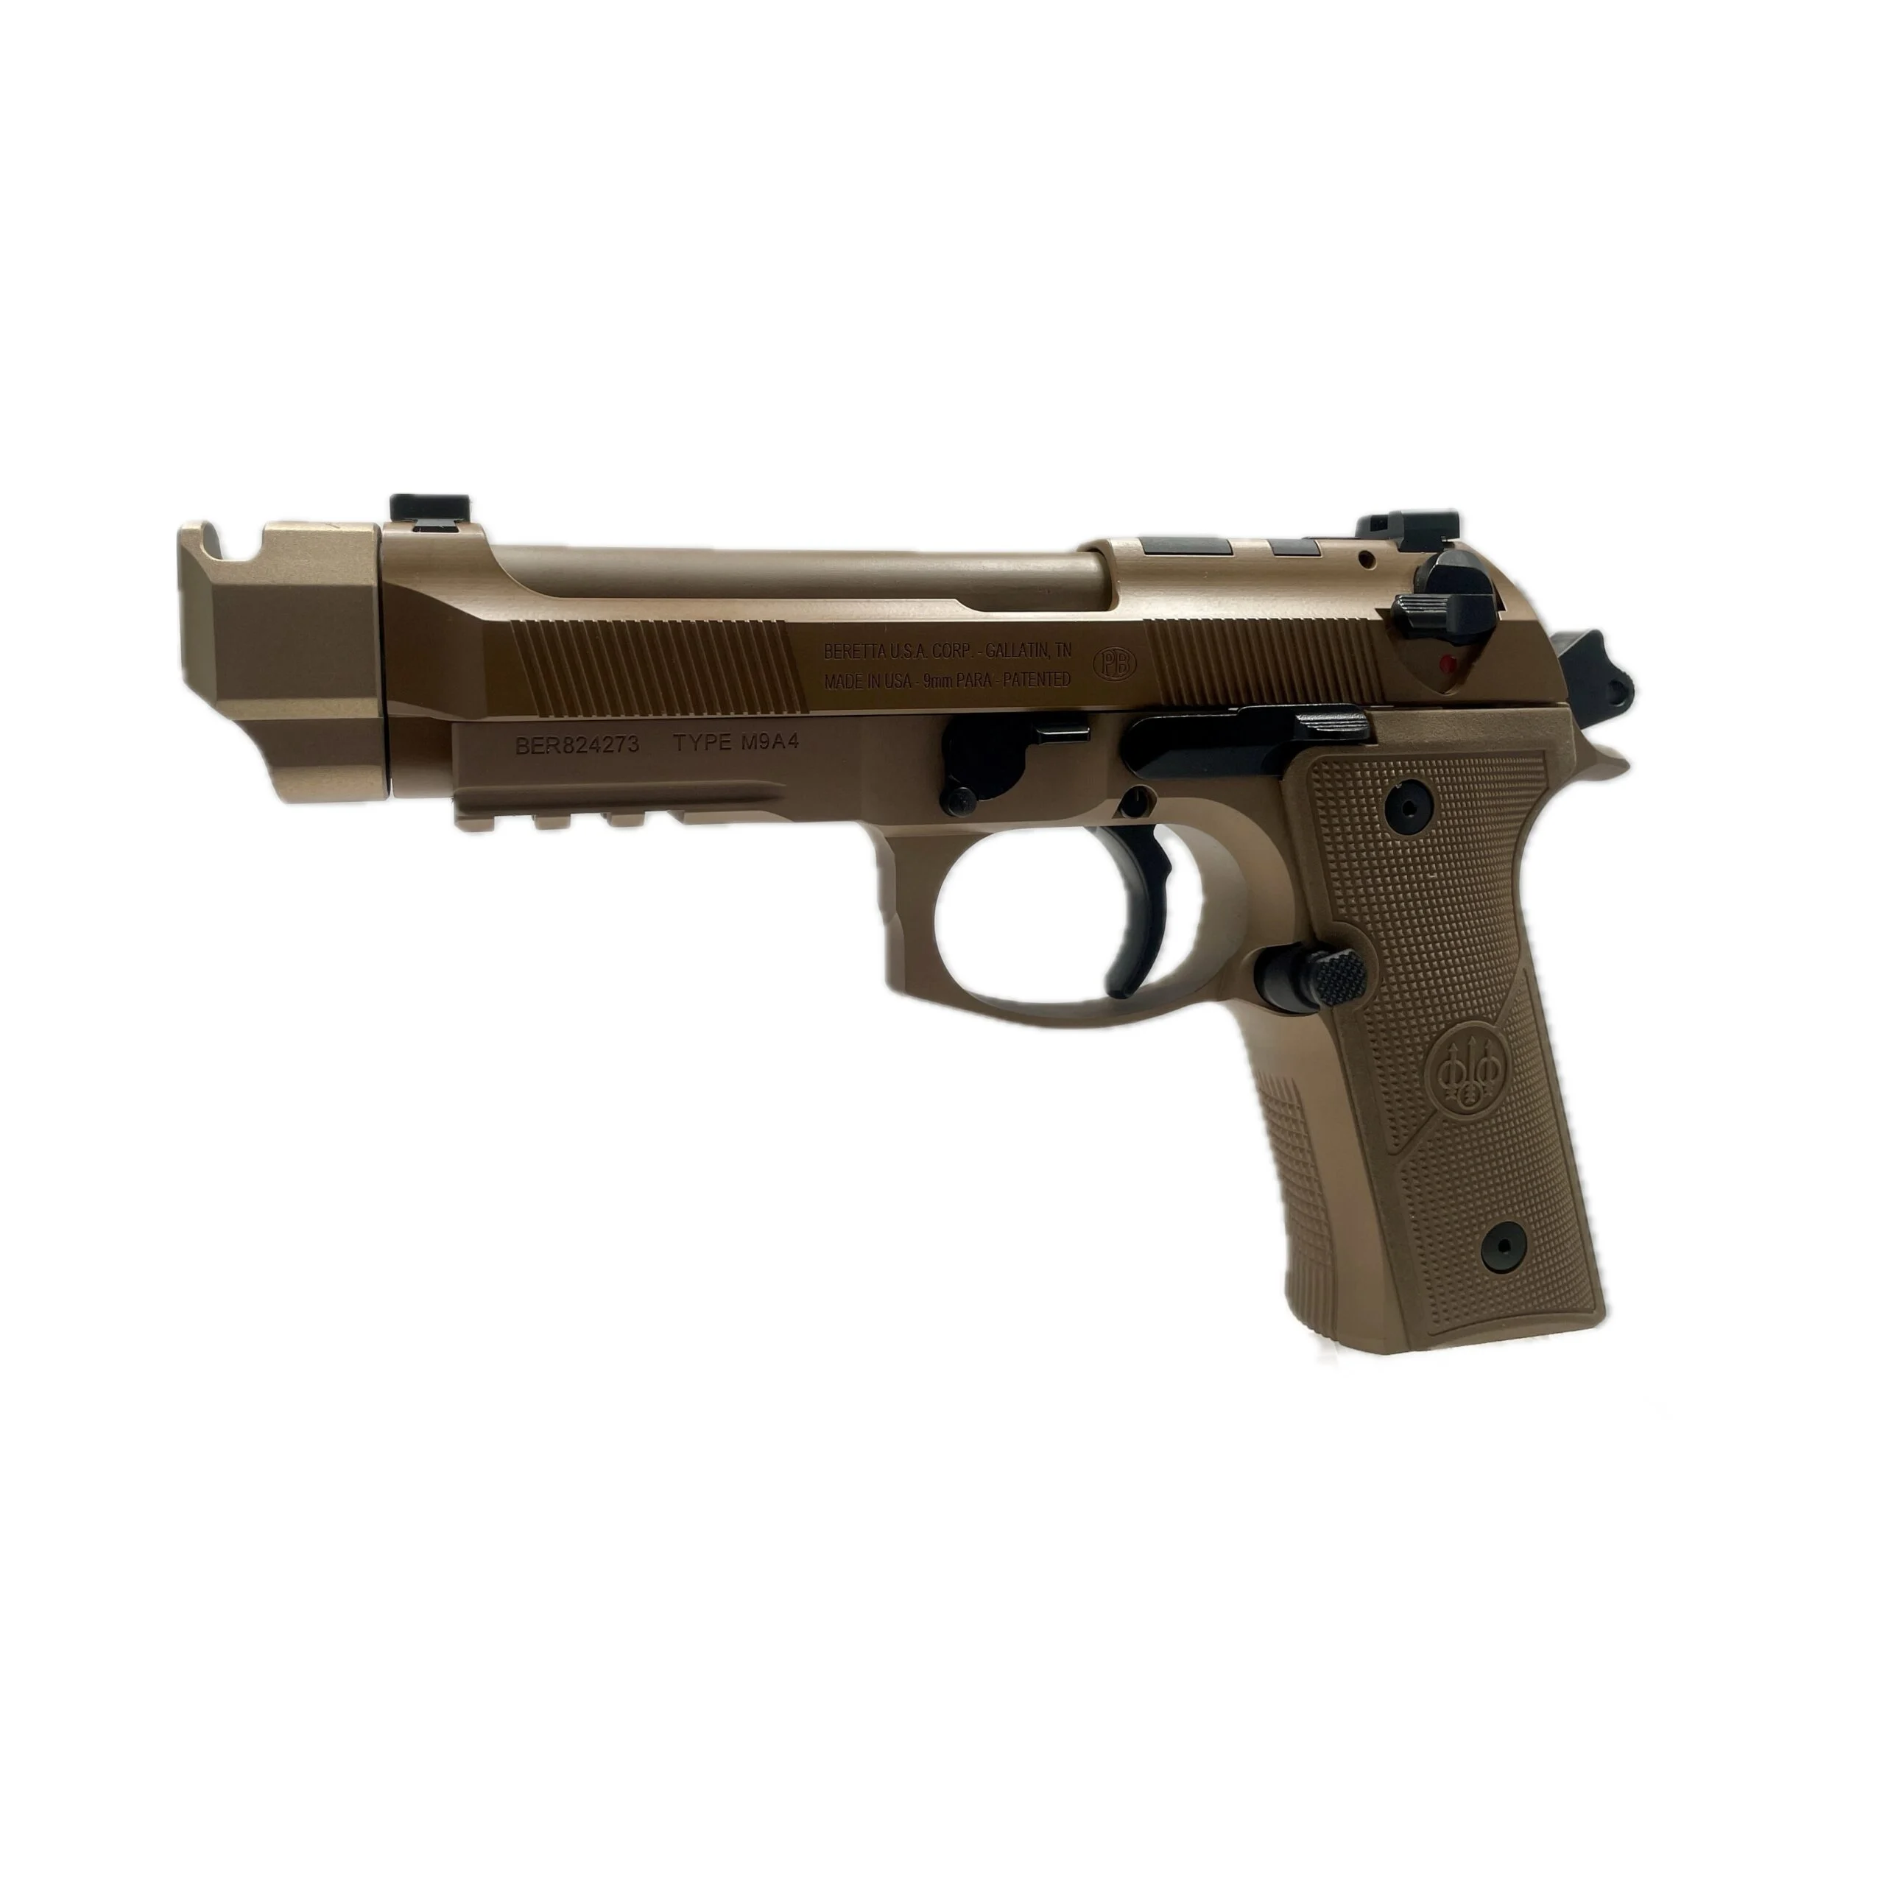
Service Pistol
The Following Pistols Are Acceptable
1911
Beretta 92/M9
.38 caliber six shot revolver

Slide 7
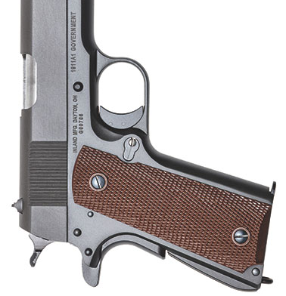
Service Pistol Course Of Fire
Two stages will be shot
Each stage will consist of slow fire, timed fire, rapid fire
Slow Fire: 10 rounds in 10 minutes
Timed Fire: 5 rounds in 20 seconds, shot twice
Rapid Fire: 5 rounds in 10 seconds, shot twice
Pause between timed and rapid to reload
Alibis apply only to the timed and rapid fire
Only one alibi may be claimed
Alibi must be on the string that shot the fewest shots

Slide 8
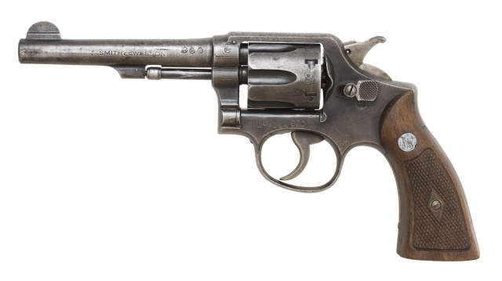
Open Pistol/22 LR Pistol
Any pistol from 22lr to 50 caliber may be used.
Only standard metallic sights may be used
Identical course of fire to service pistol

Slide 9
Conclusion
Can compete as individual or in teams or 4 and 5.
Additional information is available for those interested.
Any member in good standing can compete.
Teams can come from a detachment, a department, a pound, or a pack.
Competitors cannot be a member of more than one team.
Any Questions?

